Slide 1
Hello
Welcome to my presentation
Introduce about myself

Slide 2
INTRODUCTION
I am mudassira yahya
I I am Pakistani and I live in Karachi lyari
I am Quran tutor

Slide 3
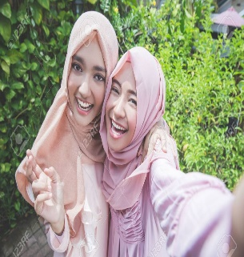
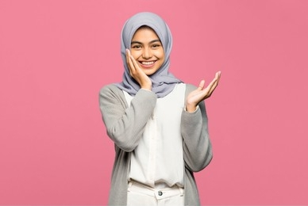
PERSONALITY
Friendly and helpful
Positive thinker
I always try to think positively
I believe in loyalty and
Truthfulness are very important in life

Slide 4

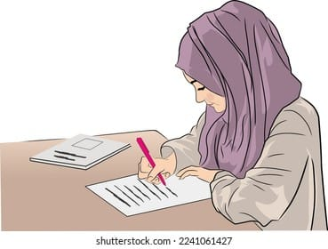

HOBBIES & INTERESTS
I like writing
cooking
And reading

Slide 5

Academy life
&
achievement
SKILLS LEARNED IN THIS COURSE
I have completed inter in commerce
Also studied dares e nizami (ALIMA)
CIT
I learned from this course technical
knowledge
MS (word excel PowerPoint)
Typing & data entry
Computer basic
Presentation design
Recently, I was selected as a compere
(host) in my school program. Being trusted with this responsibility was a
big honor and achievement for me.
And greatest achievement in my life
I have studied Dars - e - Nizami

Slide 6
FAVORITE TOPIC AND TOOL
STRENGTHS AND WEAKNESSES
FUTURE GOAL
Mathematic
&
Fiqh
If I talk about my future goal so I wanted to become a pilot
But
Now I just want to be
a educated person
My mother is my strength
But
According to situation
She is my weakness
PowerPoint
Because
According to me Education is
The Best friend and educated person is respected everywhere. Education beat the beauty and the youth.

Slide 7

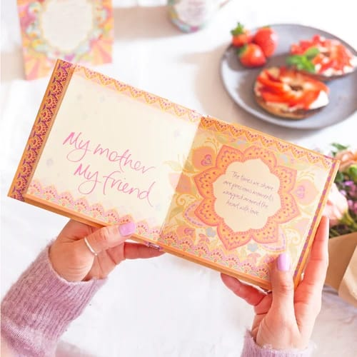
ROLE MODEL
My mother is my role model
And she is my supporting system
Fun fat about me
“ I like to collecting quotes “
That was all about me
Thank you your kind attention

